Slide 1
Group Pre
2019/06/10
caixiong
延时符

Slide 2
Flows && Parallel WaveNet
Part One: Flow-based Model
01 Nice: Non-linear Independent Components Estimation
02 Glow: Generative Flow with Invertible 1×1 Convolutions
03 WaveGlow: a Flow-based Generative Network for Speech Synthesis
Part Two: VAE Flow
04 Auto-Encoding Variational Bayes
05 Variational Inference with Normalizing Flows
Part Three: Parallel WaveNet
06 Improved Variational Inference with Inverse Autoregressive Flow
07 Parallel WaveNet:Fast High-Fidelity Speech Synthesis
Nice: Non-linear Independent Components Estimation

Slide 3


NICE Model
Main Idea:
directly modeling the p(x) is difficult, by constructing a latent variable h as a medium and finding an invertible transformation f:x-> h to model p(x)
Main Process:
construct a latent variable h
the latent h has same dimension with x
all components must be independent, i.e.,
its density is simple, e.g., standard Gaussian or Logistic Distribution
ps: hd is the d-th variable of h
ps: logistic tends to provide a better behaved gradient than gaussian
Nice: Non-linear Independent Components Estimation 2015/04 ICLR

Slide 4



NICE Model
Main Process:
choose a transformation h=f(x)
f must be invertible
determinant of the Jacobian is trivially obtained
f⁻¹ also need to be obtained easily
the log density function of data x can be computed as follow:
accoding to n-d variables density transformation formula
the training criterion is directly to maxmize the log-likelihood log(p(x) )
when the training process ended, sample from p(x) easily as follows:
samping a x is the inverible process of training
Nice: Non-linear Independent Components Estimation 2015/04 ICLR

Slide 5
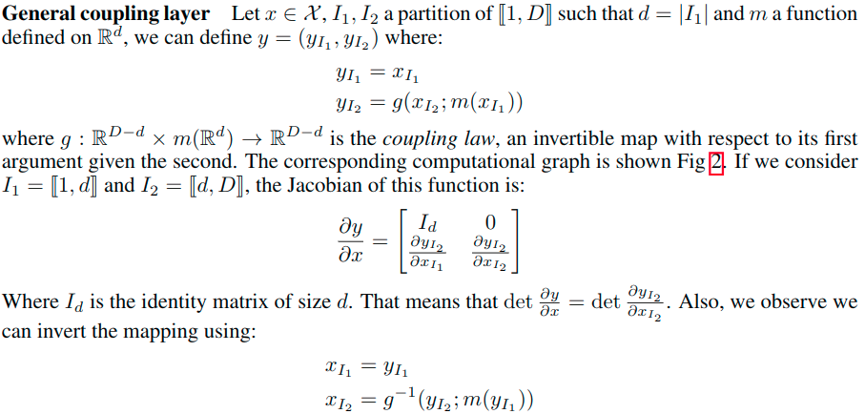



NICE Model
Key Technology: find a reasonable transformation
make a specific affine transformation?
y = wx + b , where w is a diagonal, triangular matrix or a M=LU type matrix with shape DxD, but it greatly constrains the model capacity of nn
actually, the triangular weight is not essential, we only need a triangular Jacobian matrix and a easy way to compute x=f⁻¹(h)
proposed method: Coupling Layer
additive copuling layer: paper used it
multiplicative coupling layer:
affine coupuling layer:
ps: the later two method can produce non 1 det, additive copuling with 1det
Nice: Non-linear Independent Components Estimation 2015/04 ICLR

Slide 6
NICE Model
Key Technology: find a reasonable transformatio
Combing coupling layers:
Nice: Non-linear Independent Components Estimation 2015/04 ICLR

Slide 7
PPT模板下载：www.1ppt.com/moban/ 行业PPT模板：www.1ppt.com/hangye/
节日PPT模板：www.1ppt.com/jieri/ PPT素材下载：www.1ppt.com/sucai/
PPT背景图片：www.1ppt.com/beijing/ PPT图表下载：www.1ppt.com/tubiao/
优秀PPT下载：www.1ppt.com/xiazai/ PPT教程： www.1ppt.com/powerpoint/
Word教程： www.1ppt.com/word/ Excel教程：www.1ppt.com/excel/
资料下载：www.1ppt.com/ziliao/ PPT课件下载：www.1ppt.com/kejian/
范文下载：www.1ppt.com/fanwen/ 试卷下载：www.1ppt.com/shiti/
教案下载：www.1ppt.com/jiaoan/ PPT论坛：www.1ppt.cn
THANKS
延时符

